Slide 1
Children, COVID-19, and Multisystem Inflammatory Syndrome
Carlos Leon & Paige Ramkissoon

Slide 2
Pediatric COVID-19
Underrepresented in studies
Children are recorded to have mild severity of COVID and MERS infection
Children are greatly affected by RSV, Influenza, etc
Similar symptoms as adults
Fever, cough, chest pain, loss of taste or smell, etc
Many children infected with COVID develop MIS-C

Slide 3
Multisystem Inflammatory Syndrome in Children
Can causes inflammation of heart, lungs, blood vessels, kidneys, digestive system, brain, skin or eyes
Excessive immune response
Occurs 2-6 weeks after COVID infection
Many children recover fairly quickly and do not experience long-term damage

Slide 4
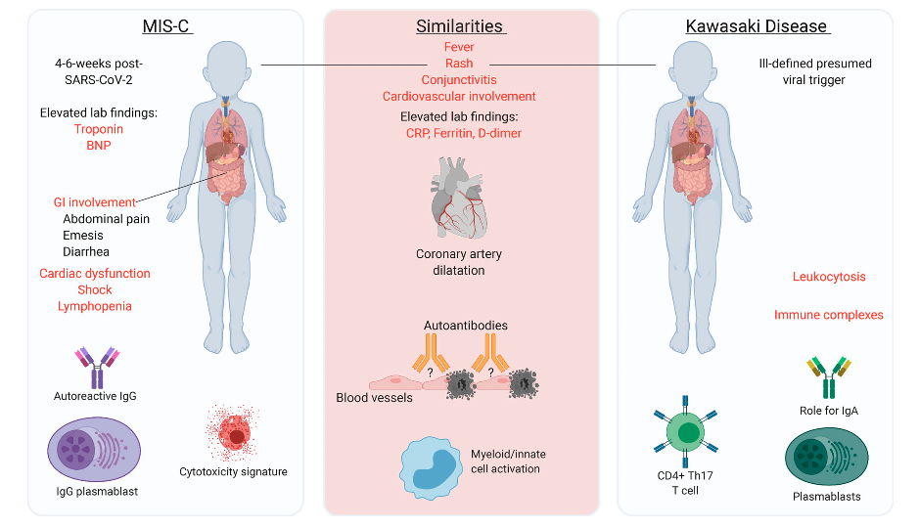
Kawasaki Disease
Individuals could be genetically predisposed
Affects children
Under 5
Mostly males
Highest incidents in Japan
Exact cause is unknown
Similar symptoms of MIS-C

Slide 5
Immunity in children with SARS-CoV-2
According to Brodin, 2022
Compared to adults, children with mild SARS-CoV-2 infection lack immunoglobulin A antibodies
Important for stimulating the innate immune system to activate the neutrophils
Upon MIS-C…
Infection is characterized by superantigen-mediated T-cell activation
TRBV11-1 gene
Alpha chains (polypeptides on the receptor)
Notes:
C
The TCR is a disulfide-linked membrane-anchored heterodimeric protein normally consisting of the highly variable alpha (α) and beta (β) chains expressed as part of a complex with the invariant CD3 chain molecules.

Slide 6
Inborn errors of immunity
Broden, 2022 describes several inborn errors of of genes within the immune system correlating with the severity of COVID-19
Toll like receptor 3
Interferon regulatory transcription factor 7
Type-I IFN receptor IFNAR
Autoimmune polyendocrine syndrome type 1 in children
Neutralizing antibodies affecting cytokines
Ex. IL-17 and type-I IFNs
Notes:
C
Immune responses fail to control viral replication, leading to imbalanced immune activation and systemic hyperinflammation and immunopathology
APS → linked to severe COVID-19 infection

Slide 7
Energy Allocation Hypothesis
Disease tolerance vs resistance
According to this hypothesis, boys need more energy resources for disease tolerance compared to girls
Energy requirement difference becomes negligible enar the age of 17-18
Can be used to explain the development of MIS-C
Reduced cytokine responses in the blood when focusing on T cell and B cell responses
Translates to mild or asymptomatic infection
Notes:
C
Since children and adolescents are growing, the hypothesis proposes that their bodies are allocating different resources for development. Therefore, they cannot afford to allocate too many resources to fighting infections, like COVID-19. This is a plausible answer as to why the COVID-19 persists in the intestines of this age population and might explain why MIS-C develops afterwards
Viral loads were found in the intestines after after COVID-19 infection → MIS-C

Slide 8
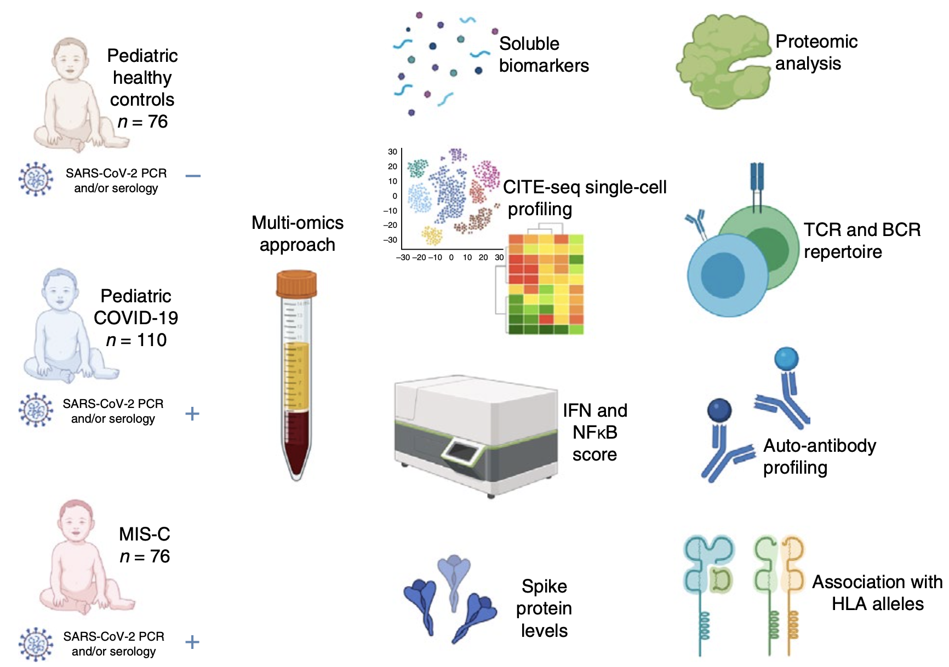
Figure 1: Study cohort and outline of the multi-omics approach
Notes:
P or C
blood samples were collected at the time when only the ancestral Wuhan strain, the B1.177 (European lineage) variant and the 1.1.7 (Alpha) variant were circulating at the centers where the patients were enrolled.

Slide 9
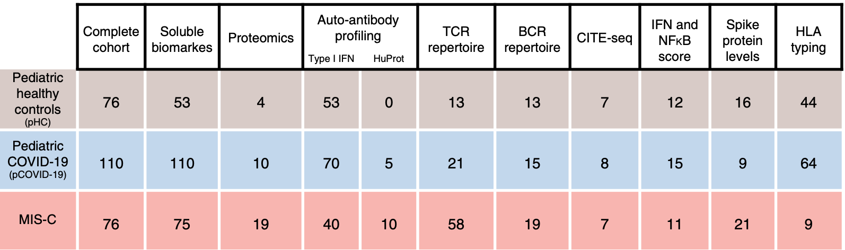
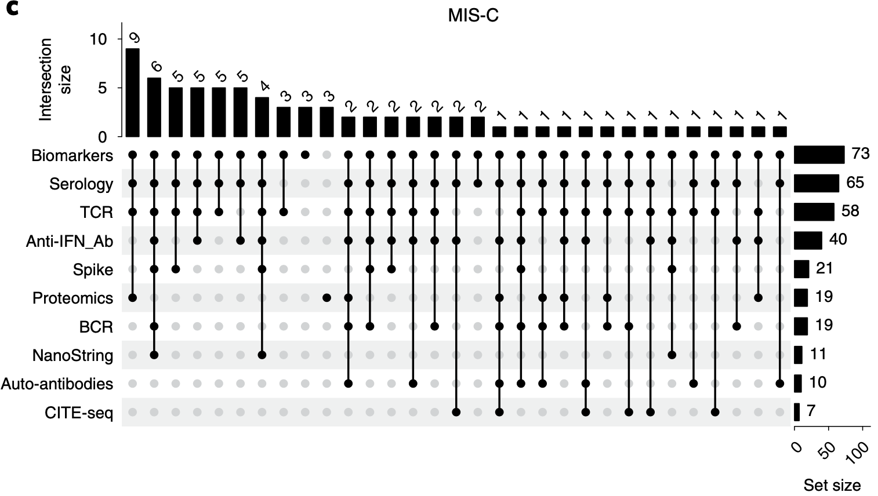
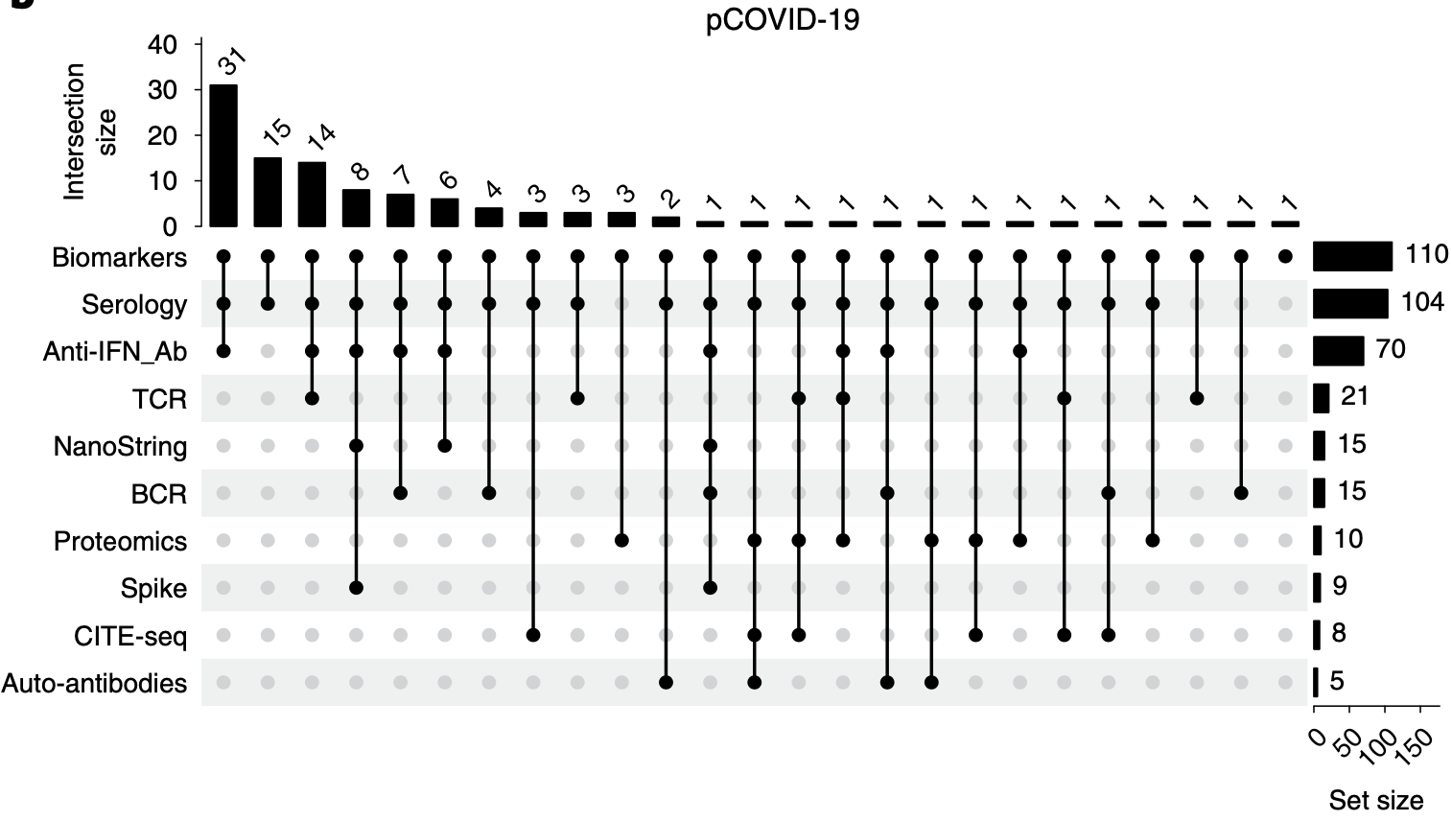
Sample Distribution
Notes:
P

Slide 10
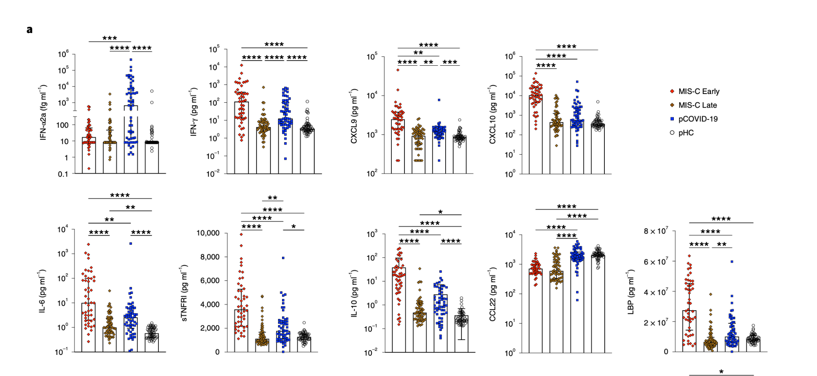
Figure 2: Blood biomarker analysis in pCOVID-19 and MIS-C
Blood biomarker analysis in pCOVID-19 and MIS-C.
Blood biomarker analysis in pCOVID-19 and MIS-C.
Notes:
C
High levels of IFN-alpha2a in pediatricCOVID-19 patients compared to other patient groups Fig. 2a
In MIS-C early patients, there was a significant increased of soluble biomarkers related to Type 1 IFN signaling, macrophage activation, endothelial injury and activation, neutrophil activation, matrisome-related inflammation, and septic shock
However, these biomarkers were significantly lower in MIS-C late patients Fig. 2a
pCOVID-19 had significantly low levels of IL-33 Fig. 2a
It’s an epithelial and endothelial alarmin
which is also expressed by hematopoietic and non-hematopoietic cells including dendritic cells, ILC2 cells, endothelial cells, and fibroblasts
Bind to immune cells, usually to toll-like receptors
Specific receptor is IL1RL1
Nanostring assay of 28 type one IFN stimulated genes in myeloid and lymphoid cells demonstrated a correlation between the high levels of IFN-alpha2a Fig. 2b
Nanostring analysis also showcased no significant differences among the expression levels of 15 type II IFN-dependent genes and 11 nuclear factor kappa beta responsive genes Fig. 2c
Fig. 2g soluble spike protein was significantly different when comparing MIS-C to pCOVID-19 and pHC
random forest classification
Used for sorting individuals into groups based on their measurements and their criteria
Fig. 2d IL-33 was the most important biomarker for distinguishing between pCOVID-19 and pHC
Fig. 2e one of the most important biomarkers distinguishing between MIS-C early and pHC was CCL2, which is important for regulating T cell homeostasis
Fig. 2f intestinal inflammation as indicated by sST2/sIL-33R was an important biomarker distinguishing between pCOVID-19 and MIS-C early
Also, myocardial damage as indicated by Reg 3A

Slide 11
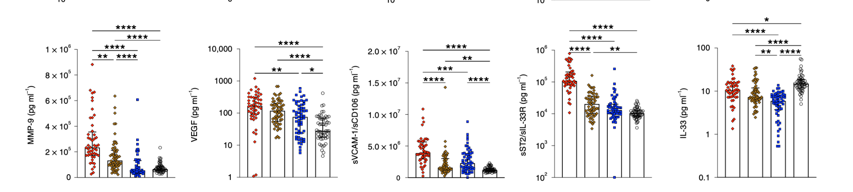
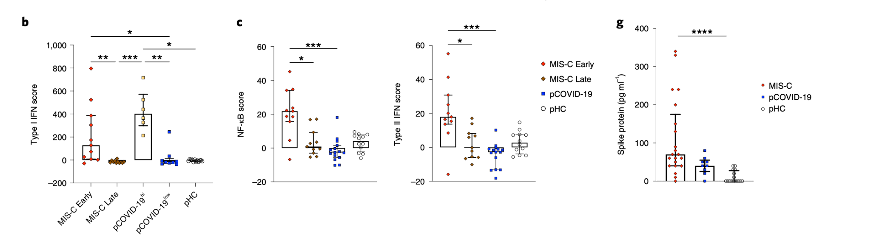
Notes:
C

Slide 12
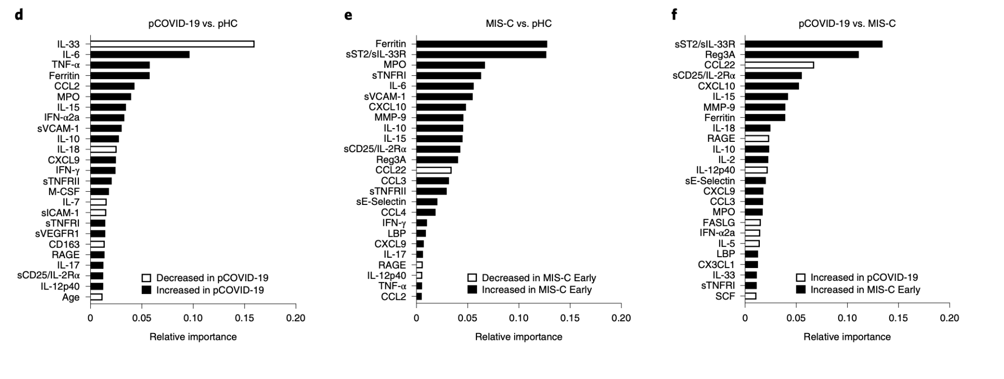
Notes:
C

Slide 13
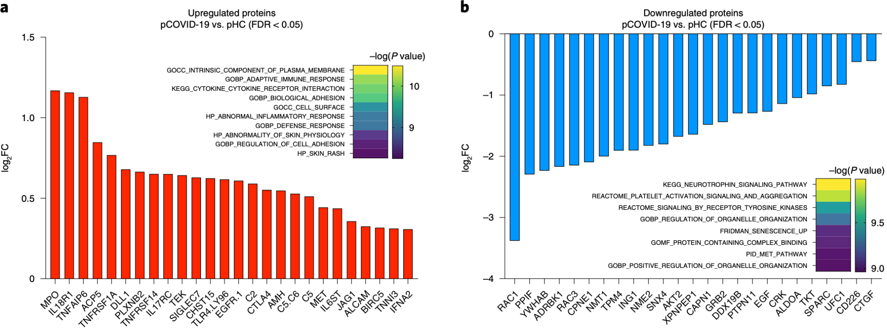
pCOVID had Increased Myeloid Activation and NK Inhibition
Figure 3: Proteomic analysis in MIS-C compared to pCOVID-19
Notes:
P
In ten patients with pCOVID-19, we observed a limited number of upregulated and downregulated proteins (26 and 25, respectively) relative to four pHCs
including increased levels of myeloid activation-associated proteins (MPO, IL18R1, TNFAIP6 and ACP5) and SIGLEC7, an inhibitor of natural killer (NK) cell pyroptosis and inflammasome activation
They also performed gene set enrichment analysis and found that the molecular signatures show that there is immune activation compatible with COVID infection

Slide 14
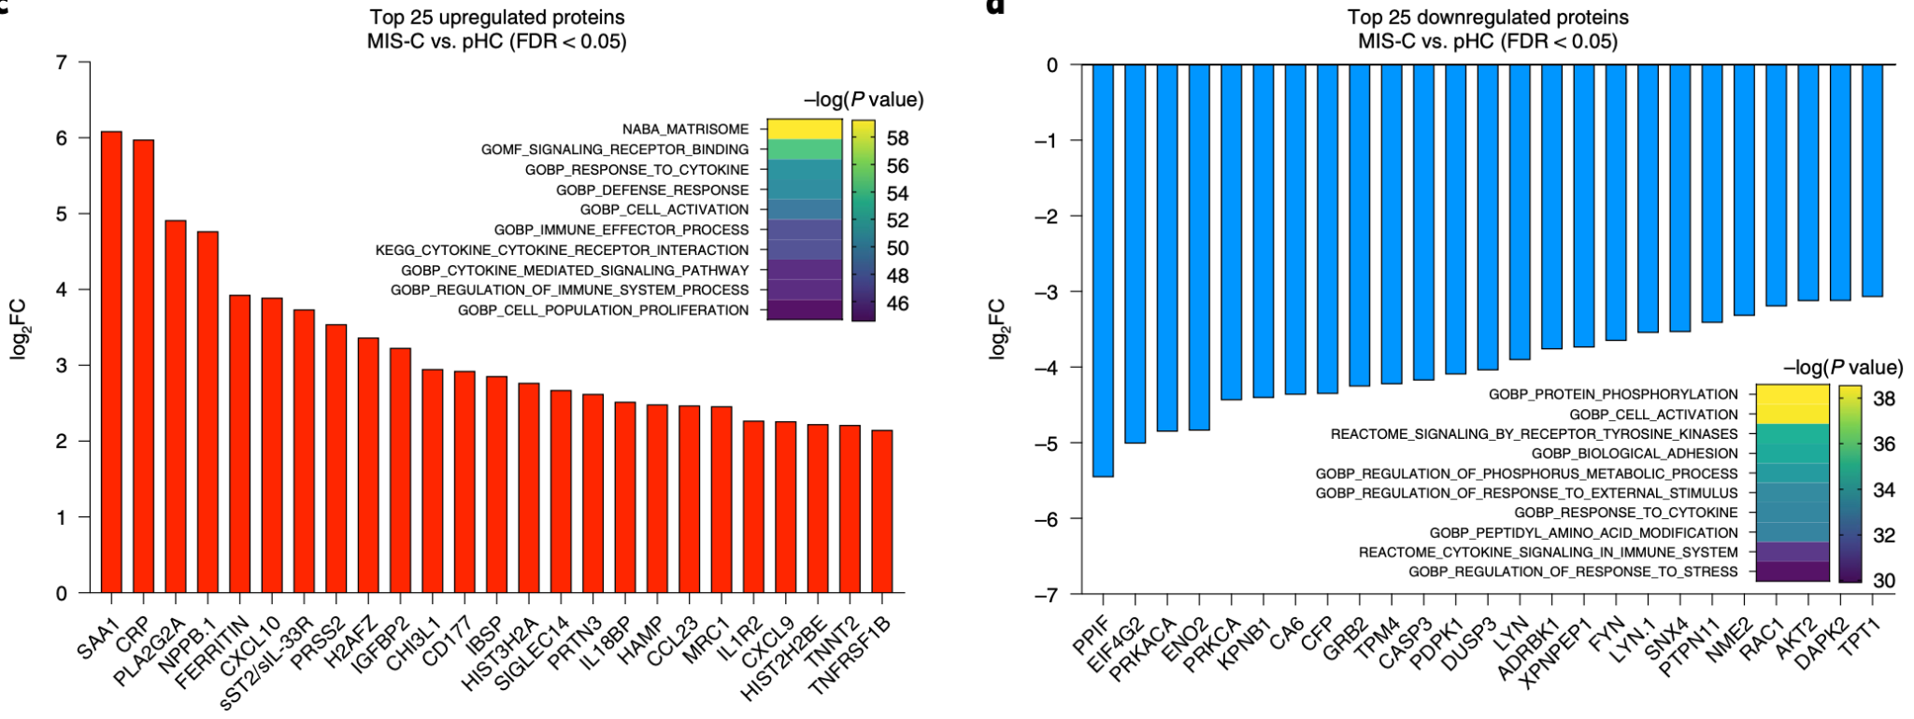
MIS-C Show a High Inflammatory Profile
Notes:
P

Slide 15
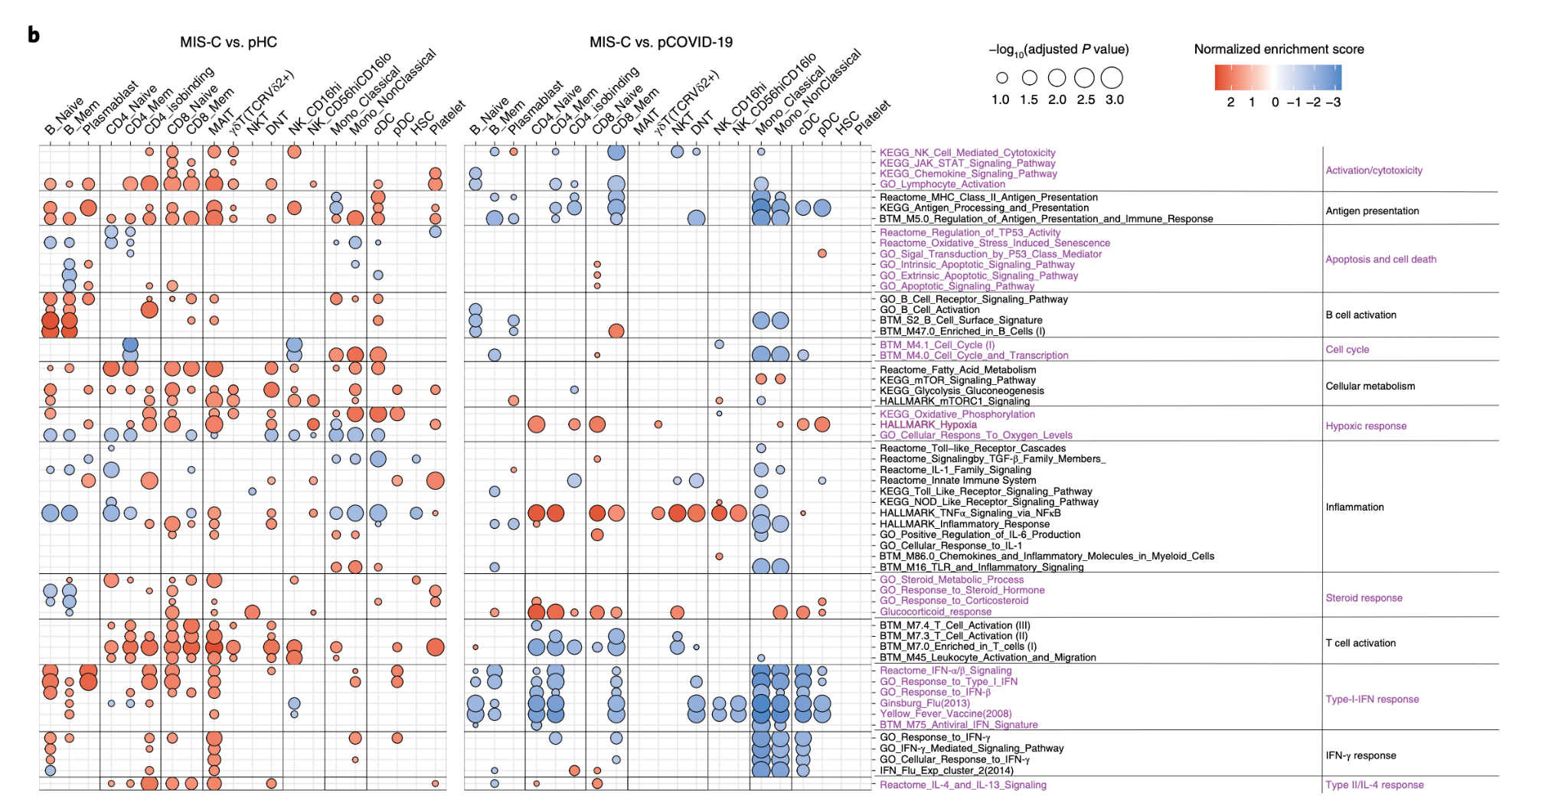
Notes:
C

Slide 16
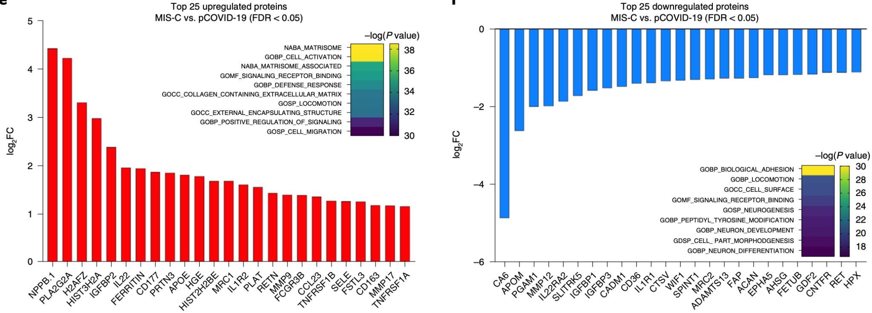
Inflammatory Activation in Higher in MIS-C than pCOVID
Notes:
P

Slide 17
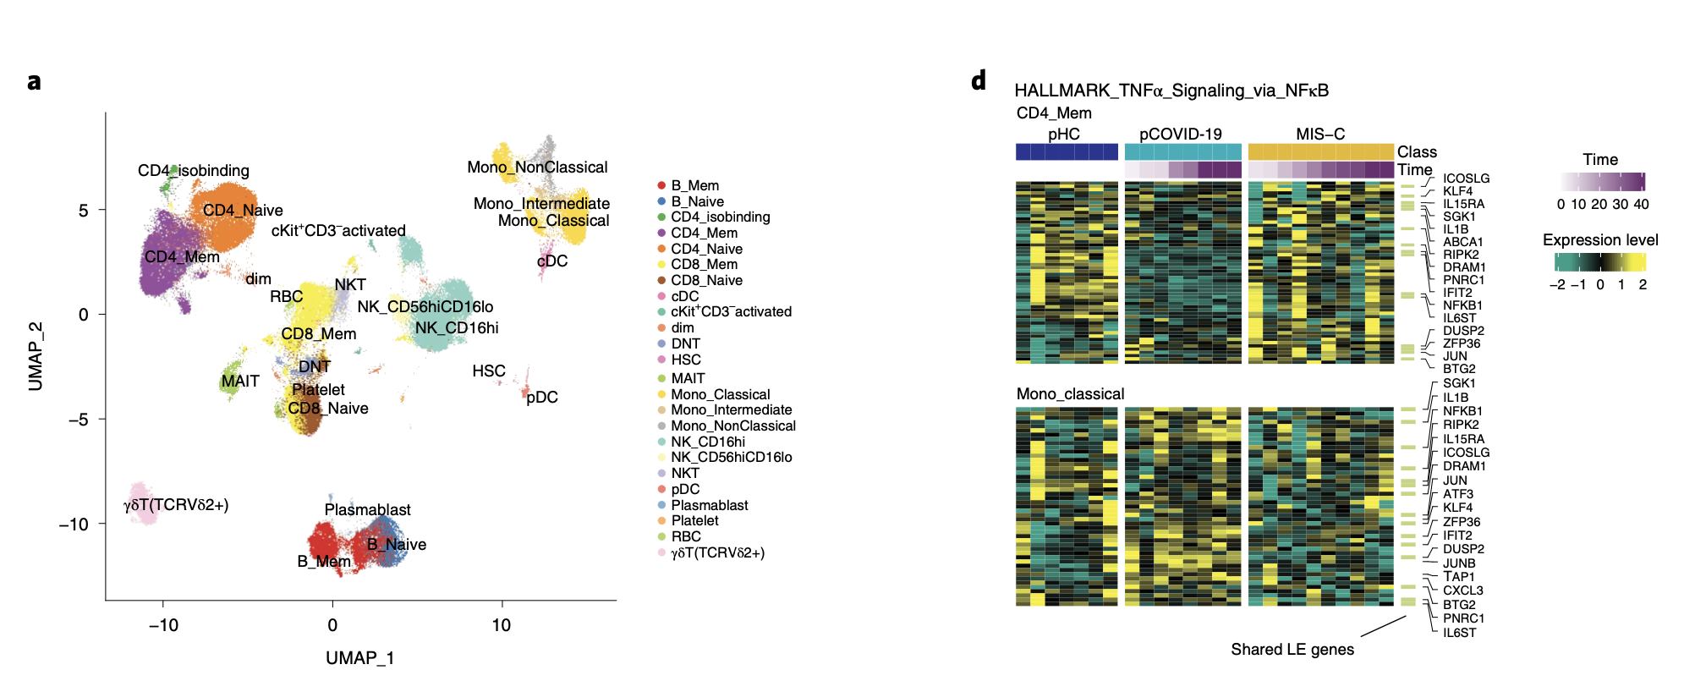
Figure 4: Multimodal single-cell profiling of MIS-C and pCOVID-19
Notes:
C
Fig. 4a CITE-seq = single-cell cellular indexing of transcriptomes and epitopes
Was done on peripheral blood mononuclear cells and non-naive T and B cells
Based on samples from MIS-C, pCOVID-19, and pHCs
There are 24 cluster populations
Fig. 4d heatmap of TNFalpha signaling via NF kappa beta gene set in CD4+ memory T cells and classical monocytes
Main takeaway is that classical monocytes from patients with MIS-C demonstrated decreased inflammatory signatures compared to pCOVID-19 and pHCs
However, CD4+ and CD8+ T cells and NK cells had lower inflammatory gene signatures in pCOVID-19 compared to MIS-C and pHCs
Linked to → (Fig. 4e shows the p values of the gene signatures comparing T cells, Nk cells, and classical and non-classical monocytes between pCOVID-19 and MIS-C)
Fig. 4b - Enrichment scores of different immune cell populations
Dot color represents the normalized gene set enrichment score
Size of the dot represents the log(p value)
Takeaway
High intensity T and B cell activation expression levels and increased antigen presentation by innate and adaptive immune cells were seen in pCOVID-19 and MIS-C when compared to pHCs
SECOND graph —> there was an enrichement of KEGG_Natural Killer_cell _mediated_cytotoxicity in CD16high NK cells from patients with MIS-C; however, there was no enrichment seen from patients with pCOVID-19
Type 1 IFN expression levels were elevated in almost all immune cell clusters in pCOVID-19 , but MIS-C patients had decreased expression of Type 1 IFN
Fig. 4c shows Type 1 IFN-related response signatures along pCOVID-19 and MIS-C
Analyzing the effect of time on on these signatures
Conclusion was that type I IFN expression level decreased in almost all cell types for pCOVID-19

Slide 18
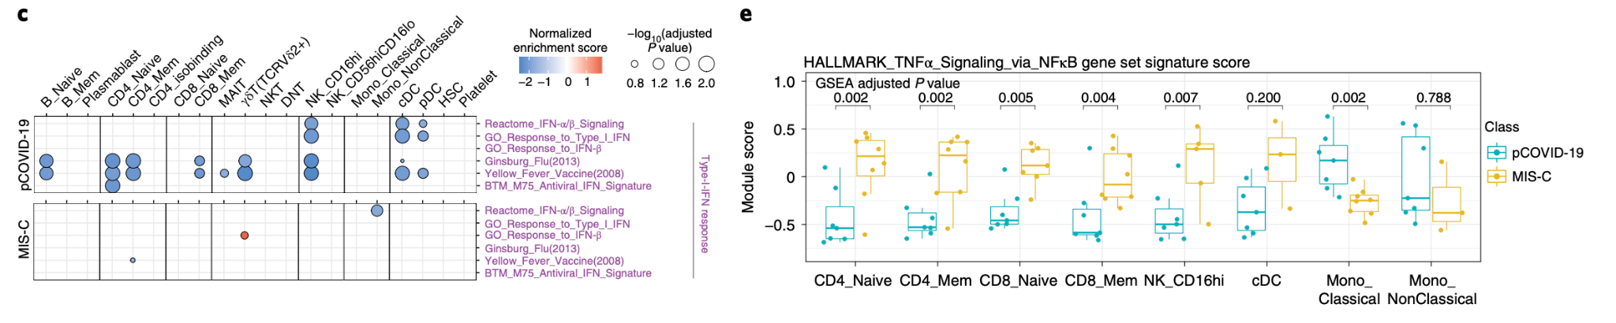
Notes:
C

Slide 19
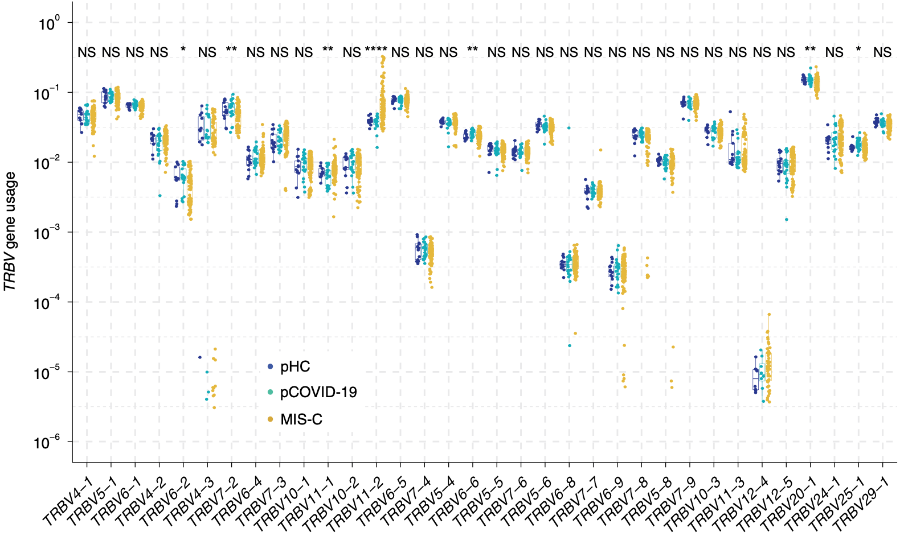
TRBV11-2 Gene Used Significantly More in MIS-C
TRBV: T-cell Receptor Beta Variance
Notes:
P
It has been previously that MIS-C have increased TRBV
T cell can have different variance determined by which genes are activated

Slide 20
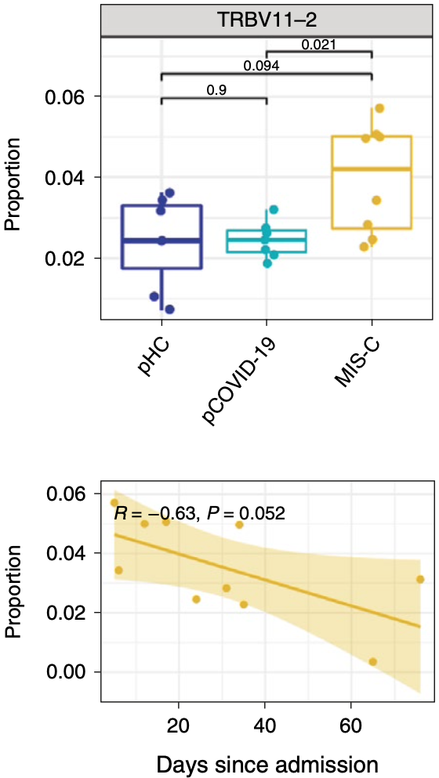
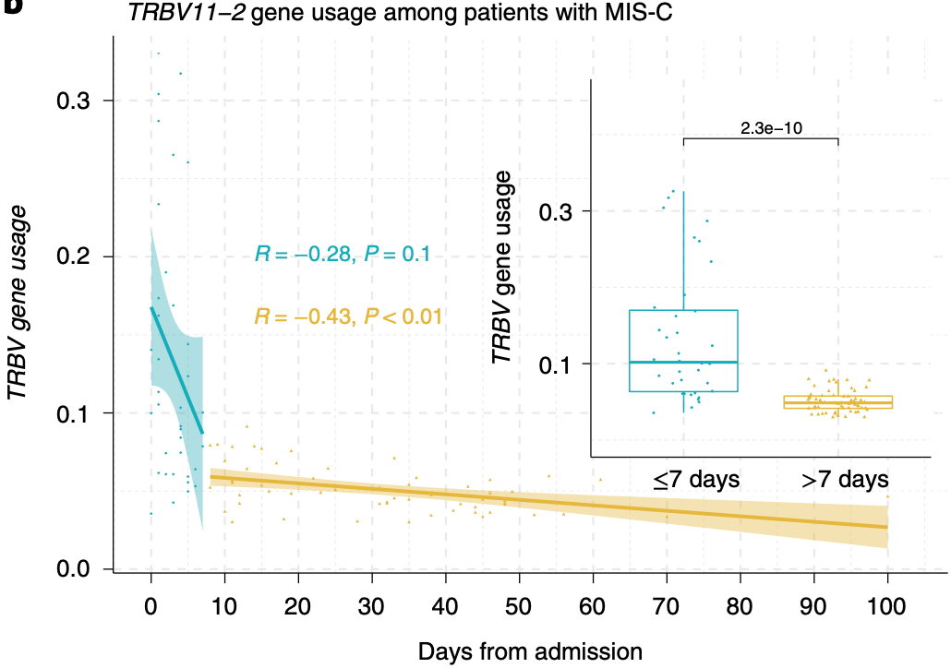
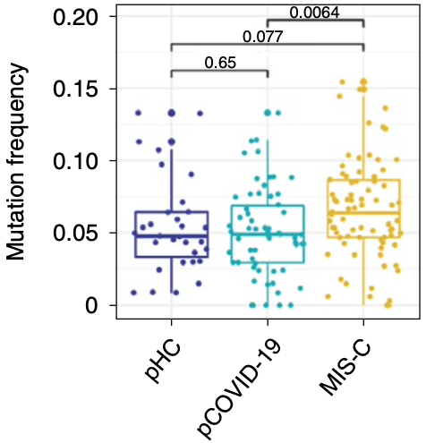
TRBV11-2 Gene Declined Soon After Hospitalization
Notes:
P
Both the increased TRBV11-2 usage and the progressive decline in the frequency of TRBV11-2 clonotypes were confirmed in CITE-seq profiling of CD4+ T cells
top: Usage of TRBV11-2 in pHC, pCOVID, and MIS-c
bottom: usage frequency in MIS-C CD4+ T cells
Right: mutation frequency

Slide 21
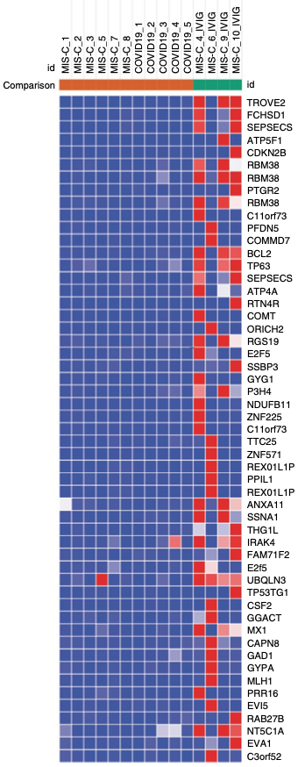
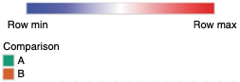
IVIG Patients had Significant Fold Changes to Auto-Antibodies
Notes:
P
To investigate the presence of auto-antibodies, they used the human proteomic (HuProt) assay comparing ten MIS-C samples (four with and six without prior IVIG treatment) to five pCOVID-19 samples.
they detected several auto-antibodies in MIS-C, including previously reported TROVE2/Ro60 and ATP4A

Slide 22
Summary
Biomarkers reveal differing immune profiles between MIS-C patients and pCOVID
Proteomics show that inflammatory response in significantly less in pCOVID
TRBV11-2 gene might play an important role in MIS-C
IVIG produces immense fold changes to auto-antibodies
Notes:
P

